Slide 1
DevOps with PowerShell for Office 365 and SharePoint Online, real world scenarios
Gilles Pommier & Ruelle Joelle
Consultant, Smartview

Slide 3






Who are we ?
Paris
SmartView.fr
Office365
MVP
Community Member
gilles.pommier
@smartview.fr
smartview.fr

Slide 4




Who are we ?
Montpellier
SmartView.fr
Office Dev MVP
RuelleJoelle
Joelle.ruelle
@smartview.fr
@RuelleJoelle

Slide 5
Today’s Menu
PowerShell & Office 365:
All you need to know
PowerShell & SharePoint DevOps
Démos and again démos !

Slide 6

The power of Powershell for Office 365
Display additional informations not visible from the admin center.
Access features that we can only configure using Office 365 Powershell.
Make bulk operations and data migrations.
Provisioning.
Extract and save data easily.
Manage all server products.
Notes:
Joelle

Slide 7

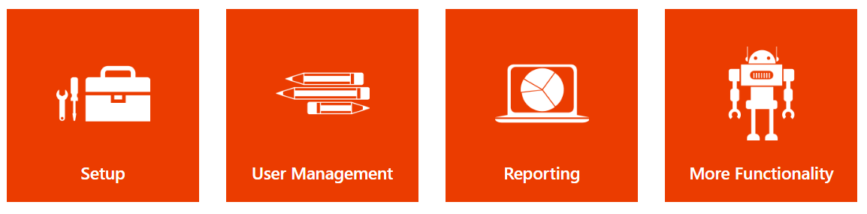
As a beginning
http://powershell.office.com/
Set of samples, scenarios and guides…
Notes:
Joelle

Slide 8
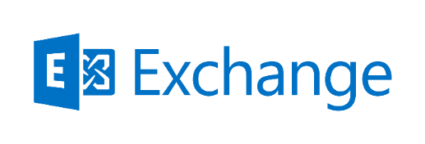
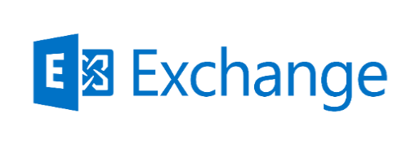

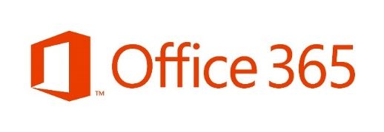

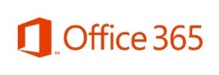

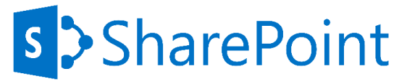
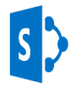
Office 365 Services
$Session =
New-PSSession -ConfigurationName
Microsoft.Exchange -ConnectionUri https://outlook.office365.com/powershell-liveid/
-Credential $credential
-Authentication Basic -AllowRedirection
Import-PSSession $Session -AllowClobber
Module Azure Active Directory (MSOnline)
Import-Module LyncOnlineConnector
$session =
New-CsOnlineSession -Credential $credential
Import-PSSession $session -AllowClobber
Import-Module Microsoft.Online.Sharepoint.PowerShell
Connect-SPOService -Url https://tenant-admin.sharepoint.com/ -Credential $c
Notes:
Joelle

Slide 9

DEMO
Create & Assign Outlook Online Signature
Notes:
Joelle

Slide 10

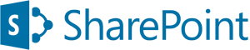




Recap
An tenant
Administrator privileges on our tenant
(or our farm)
Administrator privileges on machine
Install modules
MS Online Services Sign-in Assistant
Azure Active Directory
SharePoint Online
Skype for Business Online
Notes:
Joelle

Slide 11

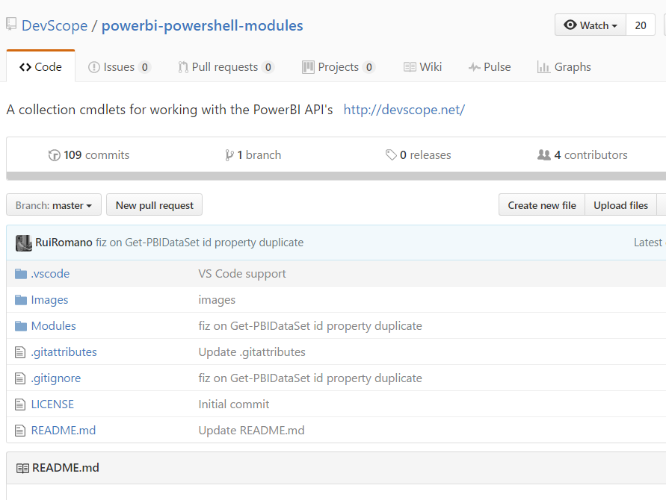
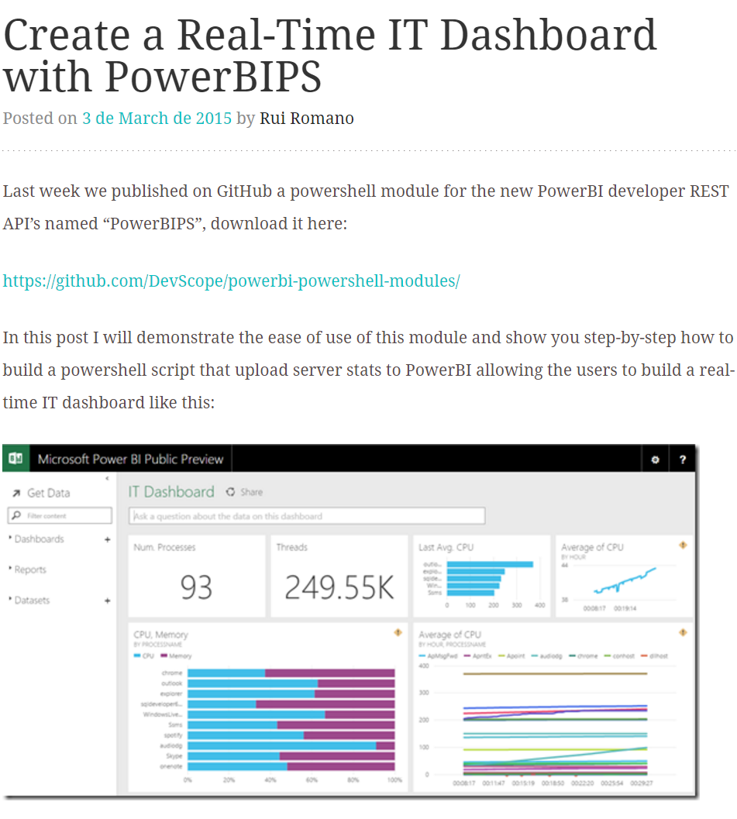
A little boost
https://github.com/DevScope/powerbi-powershell-modules
Notes:
Gilles

Slide 12
Demo
PowerShell & Power BI
Notes:
Gilles
Usage:

Slide 13
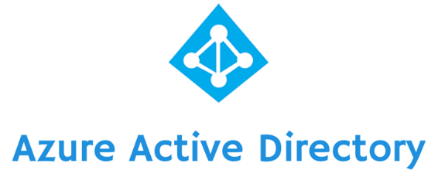

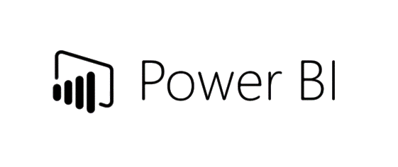
Recap
An tenant
Administrator privileges
An Authentication Token
PowerBIPS modules
Create script
Import modules
Create DataSet
Add data in
Notes:
Gilles

Slide 14
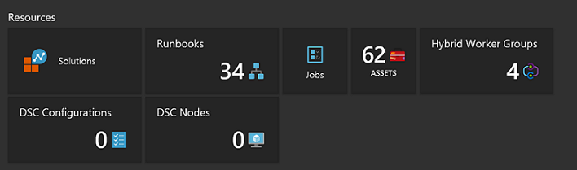

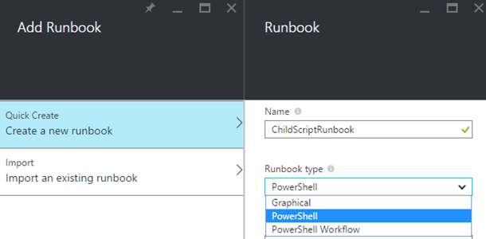
Azure Automation
Notes:
Joelle

Slide 15
Demo
Azure automation & PowerShell runbook
Notes:
Joelle

Slide 16
Tame SharePoint Online
With the SharePoint Online module.
With the SharePoint REST APIs.
With the OfficeDev PnP PowerShell commands.
With the SharePoint Client side Object Model (CSOM).
With the classical development solutions.
Notes:
Gilles

Slide 17

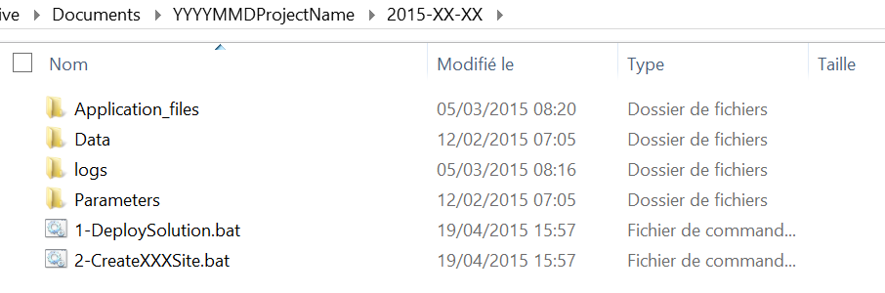
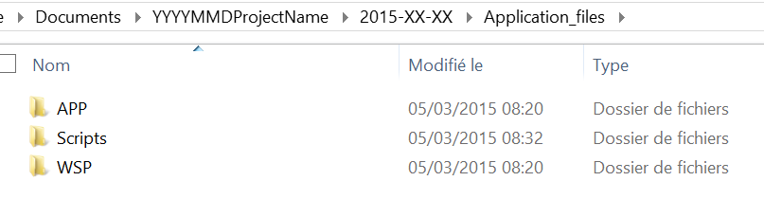
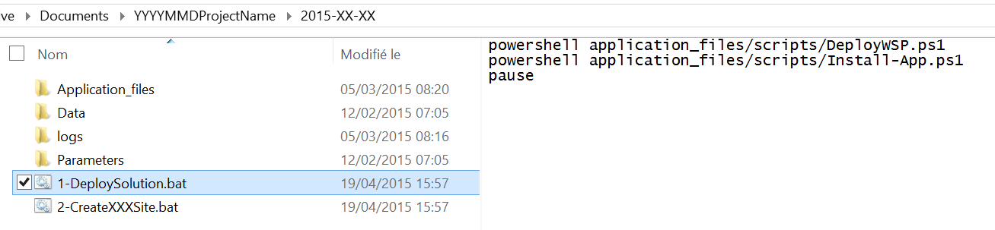
Tip and Trick: Organize your scripts
Project deployment Folder
Application Files Folder
Launcher
Notes:
Gilles

Slide 18
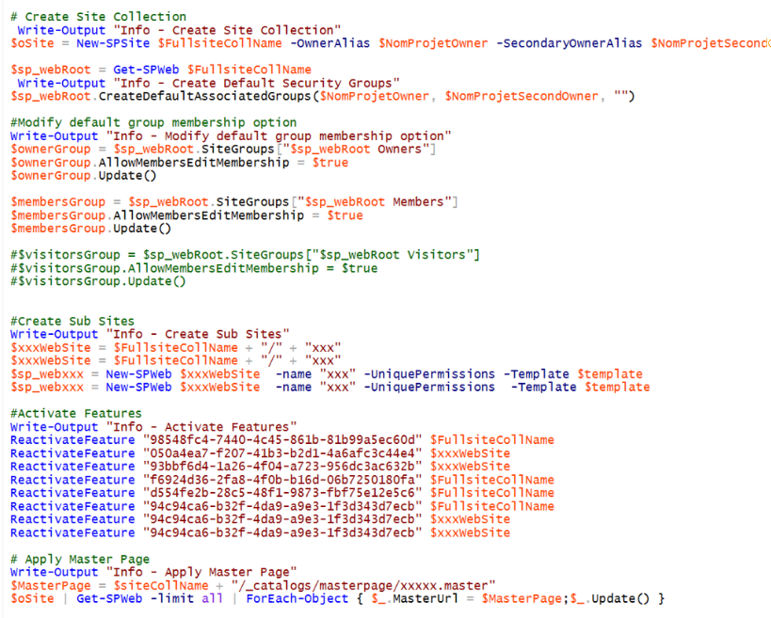
Tip and Trick: Think SharePoint
SPSite
SPWeb
SPList
SPListItem
Notes:
Gilles

Slide 19

The CmdLets
Notes:
Gilles

Slide 20

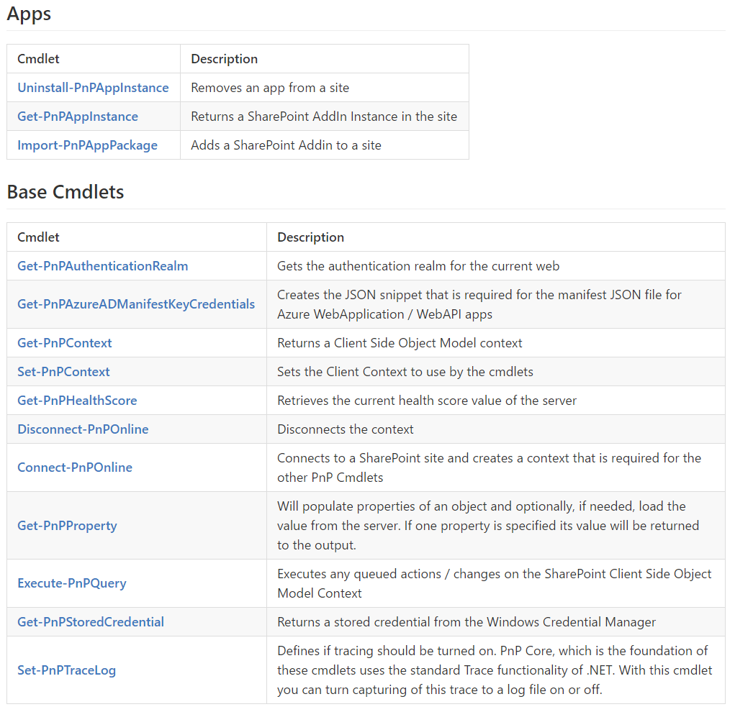
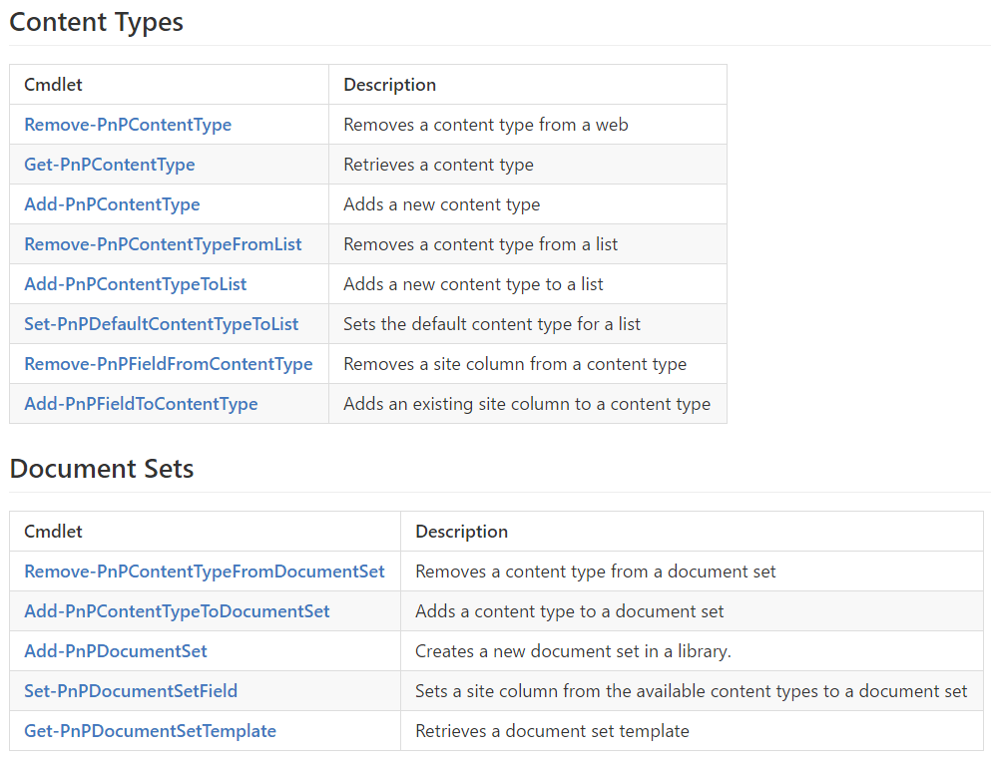
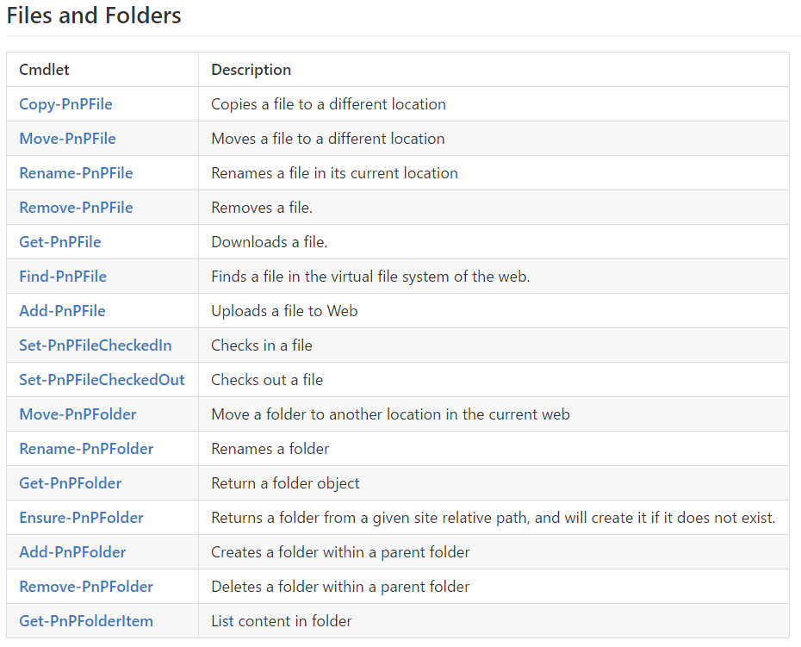
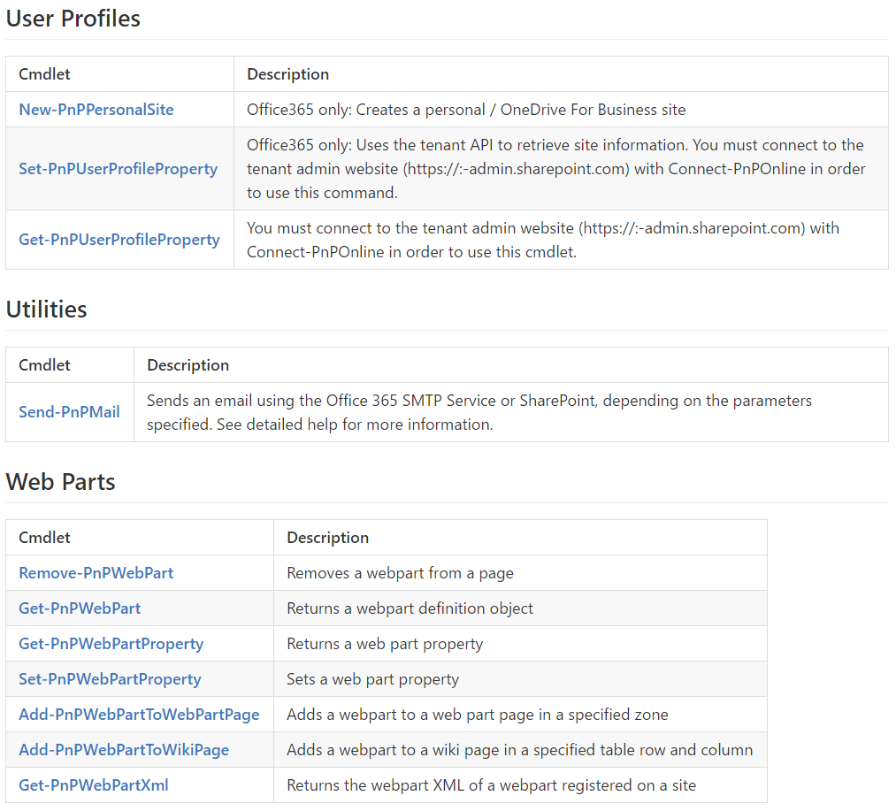
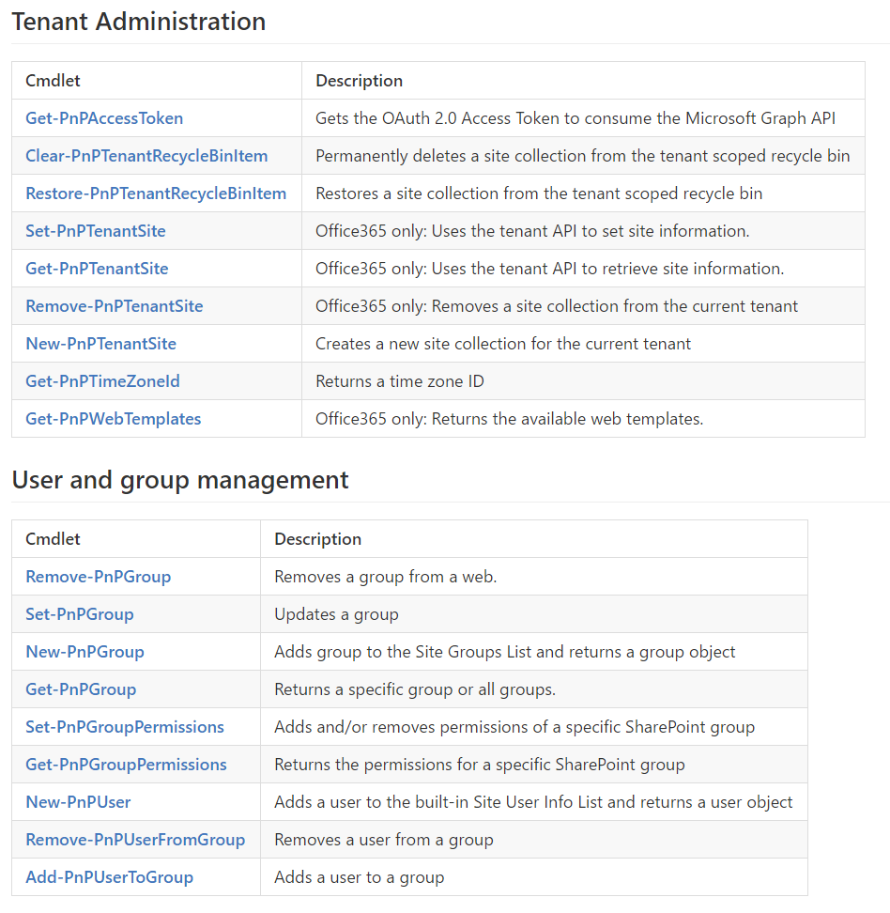
Go further: SharePoint / Office 365 Dev PnP PowerShell CmdLets

Slide 21

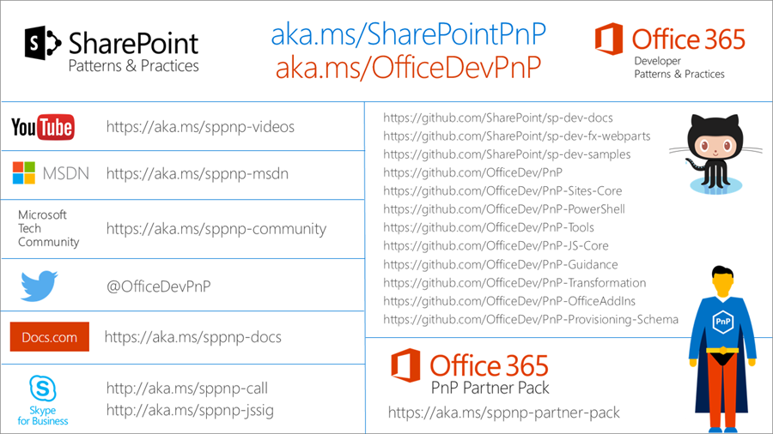
Where can we find OfficeDevPnp?

Slide 22
Demo
Automation in SharePoint
Notes:
Gilles
Usage:

Slide 23


